Slide 1

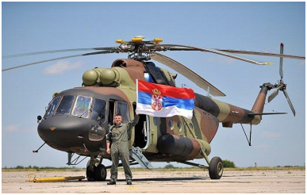
Beriša H. (2020). Development of national logistics in support of the Serbian Air Force: Long-term prospects. Vojnotehnički glasnik, 68(4). https://doi.org/10.5937/vojtehg68-22547
Figure 2. Multi-purpose medium transport helicopter Mi-17V5 (Ministry of Defense of the Republic of Serbia, 2016)
Рис. 2. Средний многоцелевой военно-транспортный вертолет Mи-17В5 (Ministry of Defense of the Republic of Serbia, 2016)
Слика 2. &lt;br&lt; Вишенаменски средњи транспортни хеликоптер Ми-17В5 (Ministry of Defense of the Republic of Serbia, 2016)

