Slide 1

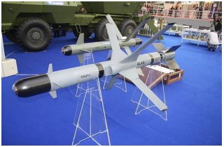
Beriša H. (2020). Development of national logistics in support of the Serbian Air Force: Long-term prospects. Vojnotehnički glasnik, 68(4). https://doi.org/10.5937/vojtehg68-22547
Figure 5. ALAS rocket system (Radio Television of Serbia, 2013)
Рис. 5. Ракетная система „АЛАС“ (Radio Television of Serbia, 2013)
Слика 5. Ракетни систем „АЛАС” (Radio Television of Serbia, 2013)

