Slide 1

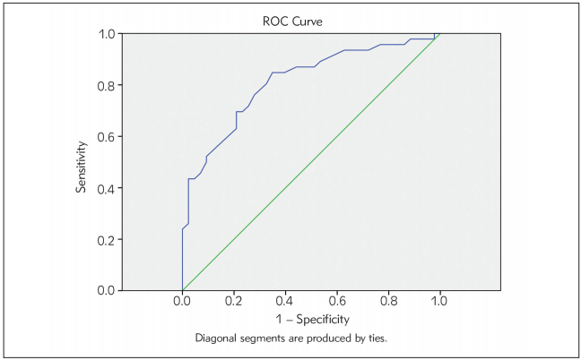
Aglan S, Elsammak M, Elsammak O, El-Bakoury E, Elsheredy H, Ahmed Y, Sultan M, et al. Evaluation of serum Nestin and HOTAIR rs12826786 C>T polymorphism as screening tools for breast cancer in Egyptian women. Journal of Medical Biochemistry. 2021;40(1). https://doi.org/10.5937/jomb0-25295
Figure 2. Receiver-operating characteristic (ROC) curves for serum Nestin

